Slide 1

DEVELOP INTEGRATION LAYER COMPONENT FOR OPEN BANKING
Project submitted in partial fulfillment of
the Requirements for the Award of the
Degree of B.Tech in
Computer Science Engineering
BY
SAURAV VERMA
2010767, CSE & BDA
Under the guidance
Of
Mr. Debdas Mondal
Technology Lead, FS Star, Infosys Limited

Slide 2
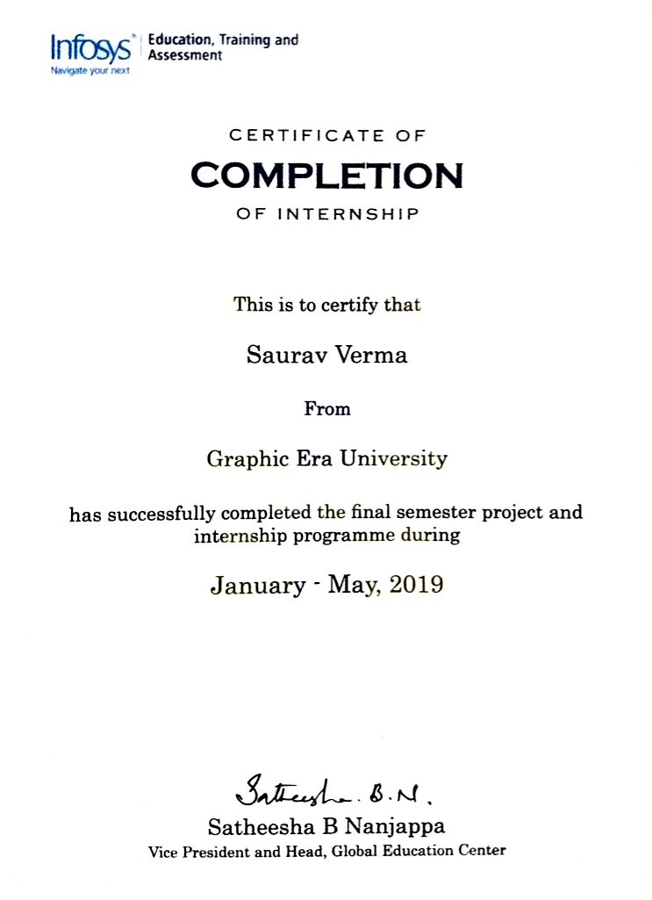

Slide 3
Table of Content
Project Overview
Requirement Analysis
Problem Statement
Planning
Designing
Implementation
Testing
Conclusion
Future recommendations

Slide 4
PROJECT OVERVIEW
This project aimed at developing integration layer component for the open banking and such services by which the bank can share financial information electronically, securely, and only under conditions that customers approve of.
Application programming interfaces allow third-parties to access financial information efficiently, which promotes the development of new apps and services which would help individual save money, borrow easily and pay painlessly.

Slide 5
REQUIREMENT ANALYSIS

Slide 6
Open APIs for banking
APIs are at the heart of open banking.
A key concept in the open banking paradigm is to use open source technologies to enable third-party developers to build financial applications on top of the banks’ existing infrastructure.
The need for new products and services to serve increasingly multichannel customers and create more personalized relationships requires the development of Open APIs.

Slide 7
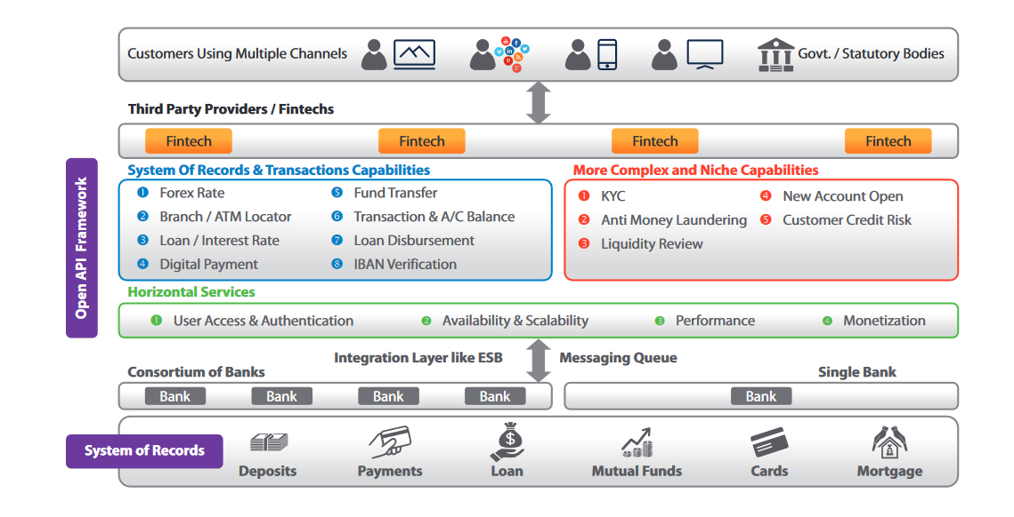

Slide 8
Micro Services
Microservices also known as the microservice architecture is an architectural style that structures an application as a collection of services.
Its main principle is to break single large monolithic system into multiple independent component.
Microservice architecture offers:
Fast Development
Scalability
Better fault tolerance
Eliminates technology dependency
Easy understanding

Slide 9
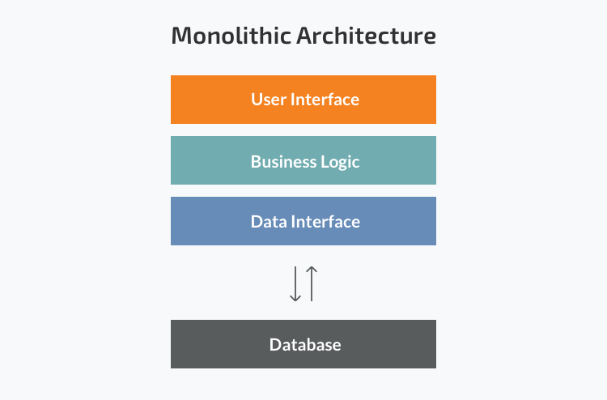
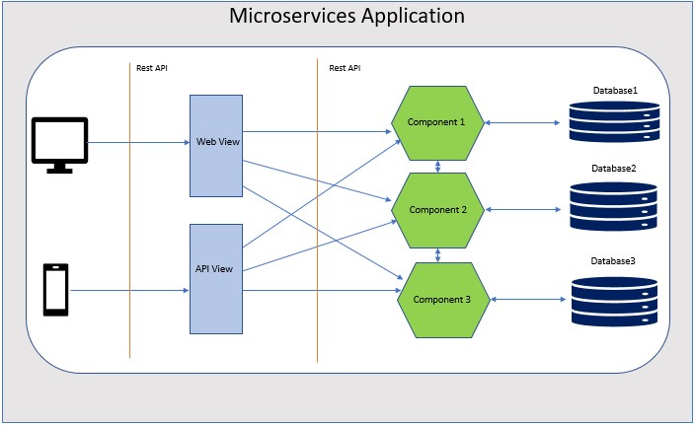

Slide 10
Spring Boot
Spring Boot is an open source Java-based framework used to create a micro Service.
It is used to build stand-alone and production ready spring applications.
Spring Boot is designed with the following goals −
To avoid complex XML configuration in Spring
To develop a production ready Spring application in an easier way
To reduce the development time and run the application independently
Offer an easier way of getting started with the application

Slide 11
Swagger
Swagger is a set of rules (in other words, a specification) for a format describing REST APIs.
Swagger provides a set of great tools for designing APIs and improving the work with web services:
Swagger Editor: It enables to write API documentation, design and describe new APIs, and edit the existing ones.
Swagger Codegen: It allows developers to generate client library code for different platforms.
Swagger UI: It allows engineers to get self-generated documentation for different platforms.

Slide 12
Config Server And Eureka Naming Server
Spring Cloud Config is Spring's client/server approach for storing and serving distributed configurations across multiple applications and environments.
It is an Http resource-based API for external configuration.
It has encryption and decryption values also known as symmetric and asymmetric.
It can be used easily in a Spring Boot application using @EnableConfigServer.
Eureka Server also known as Discovery Server is an application that holds the information about all client-service applications. Every Micro service will register into the Eureka server

Slide 13
SOFTWARE HARDWARE REQUIREMENTS REQUIREMENTS
Java 8
Eclipse Oxygen IDE for Java developers, 64-bit
Visual Studio Code v1.31, 64-bit
Apache Spring Boot v2.0.4
Apache Maven v3.5.3
AngularJS v4.0
Maven
Swagger
Postman
JPA
Eureka
Windows 7 Enterprise 64-bit/10 64-bit
8 GB RAM (minimum)
Ethernet
Processor: 2GHz (minimum)

Slide 14
Problem Statement
Develop the user interface and implement APIs using Swagger UI for an open banking login portal. Create a dummy service to implement the authentication process of the user details and develop integration layer component for the open banking and also peripheral services using Eureka naming server that would support the smooth execution and usage of the microservices.

Slide 15
PLANNING

Slide 16
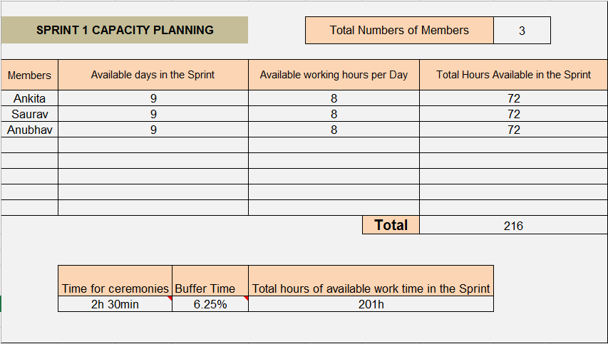
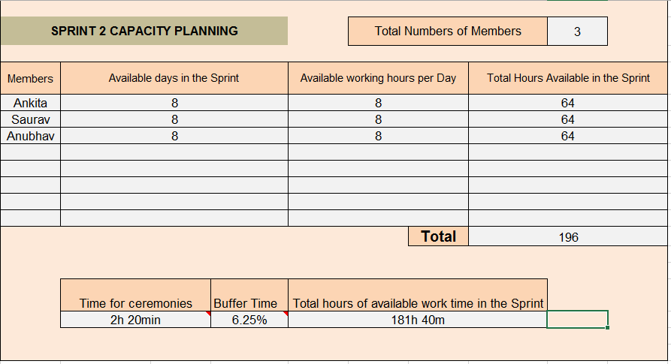

Slide 17
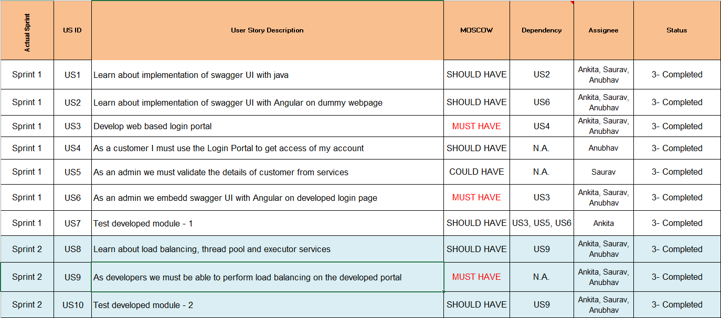

Slide 18
DESIGNING

Slide 19
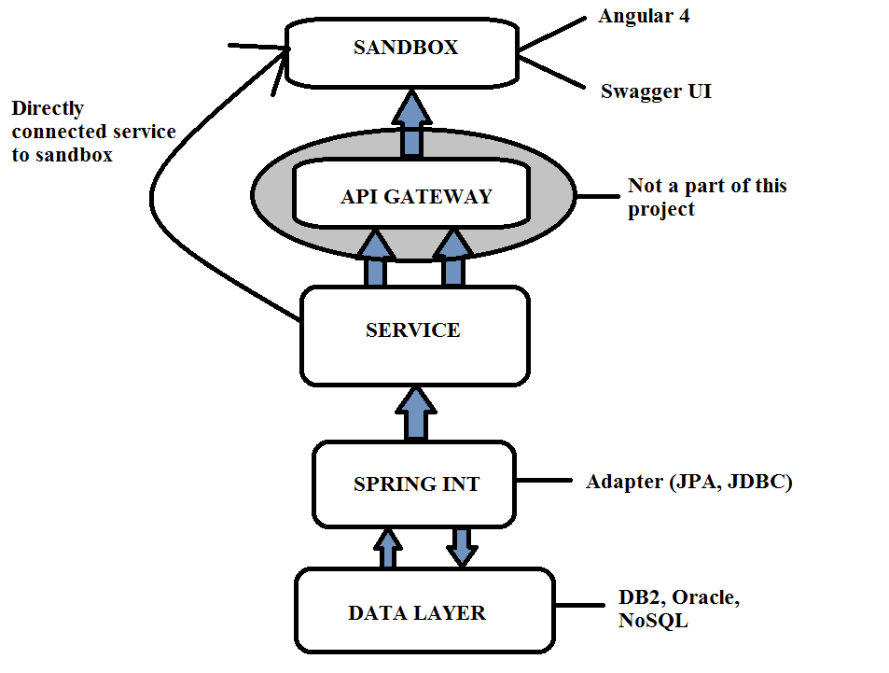
CONTROL FLOW DIAGRAM

Slide 20
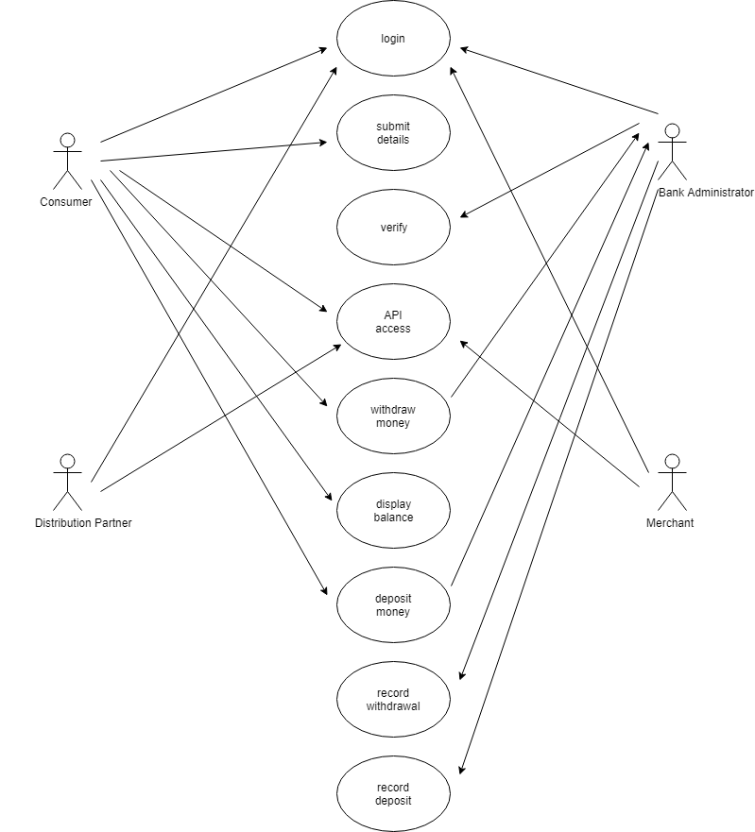
- The actors in use case diagram are Consumer, bank administrator, database, merchant, and distribution partner. - The use cases are Login, give details, verification, withdraw money, deposit money, report, deposit, API access and report withdraw. - The actors use the use case are denoted by the arrow
USE CASE DIAGRAM

Slide 21
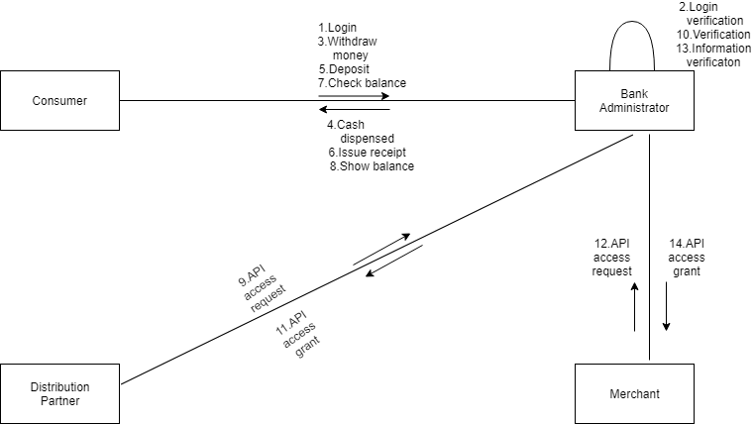
COLLABORATION DIAGRAM
The collaboration diagram is to show how the consumer registers and the authorities maintains the details of the logged in consumer in the bank system.
Here the sequence is numbered according to the flow of execution.

Slide 22
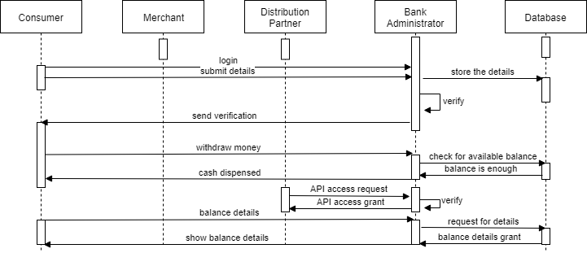
SEQUENCE DIAGRAM
The consumer submitting details and ask for different functions from the bank administrator.
The verification done by the bank system and sending acknowledgement for actions.
Searching the database with login and displaying it for maintenance.

Slide 23
IMPLEMENTATION

Slide 24
FRONT END
In angular we have used the command ng new component to make the new component in app.component.html and have used various bootstrap part as nav bars in which we have used and called the router outlet by using tag <routeroutlet></routeroulet>.
In app.module.ts we have added a component as LoginComponent and in app-routing.module.ts we have added the routers part and add the link of the login component.
In login part we have used validators which will validate that the account number, customer name and password.
When the login is done the Swagger local host is open and the API is tested.

Slide 25
LOAD TESTING USING THREADS
Each time a new user accesses the login page, a new thread is generated. Threads run continuously and work as sessions for every user.
Load testing can be performed by threads by means of traffic created on the server by them, hence giving the idea of the number of users that a website can handle at a given moment without compromising it’s responsive nature.
The thread or program (small functionality) are integrated and tested incrementally as a subsystem, and then executed for a whole system.

Slide 26
BACK END MICROSERVICES - 1
Entity class: We created a class named Account Entity for mapping with database in our project. Hibernate detects that the @Id annotation is on a field and assumes that it should access properties of an object directly through fields at runtime.
Model class:
Account(AccountEntity obj): This parameterized constructor used to initialize the parameters like account_no by the value of account_no get by the AccountEntity class.
getAccount_type(): This function return the account_type to the class.
setAccount_type(String account_type): This function is to initialize the local account_type parameter with the returned account_type.
-Service Class:
getAllAccount(): This function uses the inbuilt findAll() method of JPA repository for fetching the data. The data later on stored in the list and the function returns the accountlist.
getById():This function uses the inbuilt findOne(id) method of JPA repository for fetching the data uniquely and returns it.
Controller class:
By annotating the controller class with @RestController annotation, you no longer need to add @ResponseBody to all the request mapping methods and autowiring of AccountService is done.

Slide 27
BACK END MICROSERVICES - 2
Main class: We created rest template bean by using the @Bean annotation.
Service class: In this project we created a service class named as Account Service.
getAllAccount(): This method is override from the FirstService AccountService class. In this method a function getbody() is used which is inherited from springframework.http.HttpEntity class for fetching the details.
getById(Id): This method is also override from the FirstService AccountService class. In this method a function getbody() is used which is inherited from springframework.http.HttpEntity class for fetching the details of single account which matches the account_id uniquely.
Controller class: In this project we created a class named as Account Controller.
@RequestMapping(“api”): This annotation maps HTTP requests to handler methods of MVC and REST controllers.
@GetMapping(“/accounts”): This annotation to map HTTP GET requests onto specific handler methods for fetching all the accounts details.
@GetMapping(“/account/{id}”): This annotation to map HTTP GET requests onto specific handler methods for fetching the unique account details based on account_id.

Slide 28
TESTING

Slide 29
Testing of Angular And Swagger UI
We have details of two customers in our API. One can either check their account details or add a new account if the user is not previously registered. The customer details we have are:
Account Holder Name: XYZ Account Number: 123456789100 Account Password: ABC123 Account Holder Name: INFOSCION Account Number: 112019202000 Account Password: MYS123

Slide 30
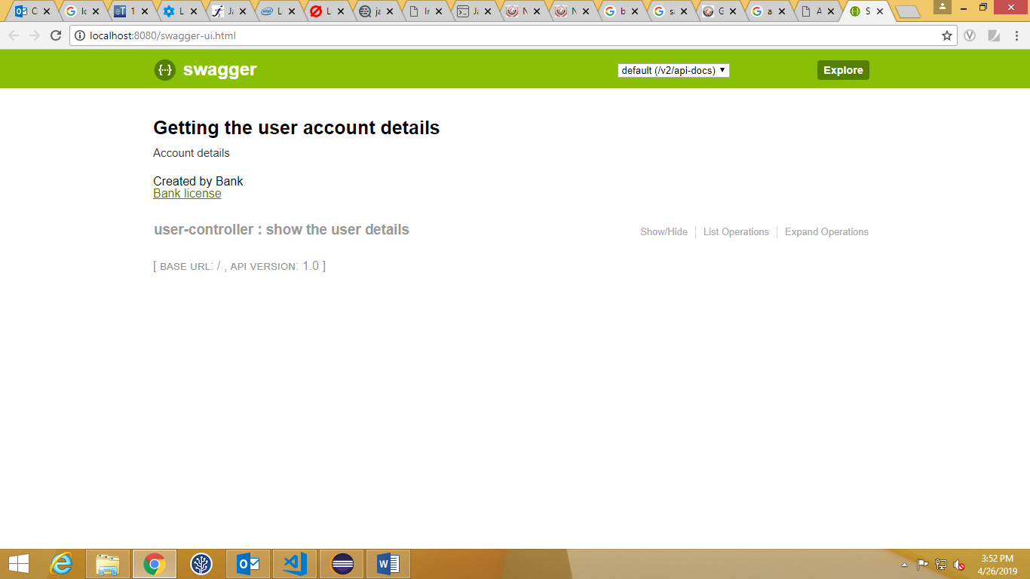
White Box Testing

Slide 31
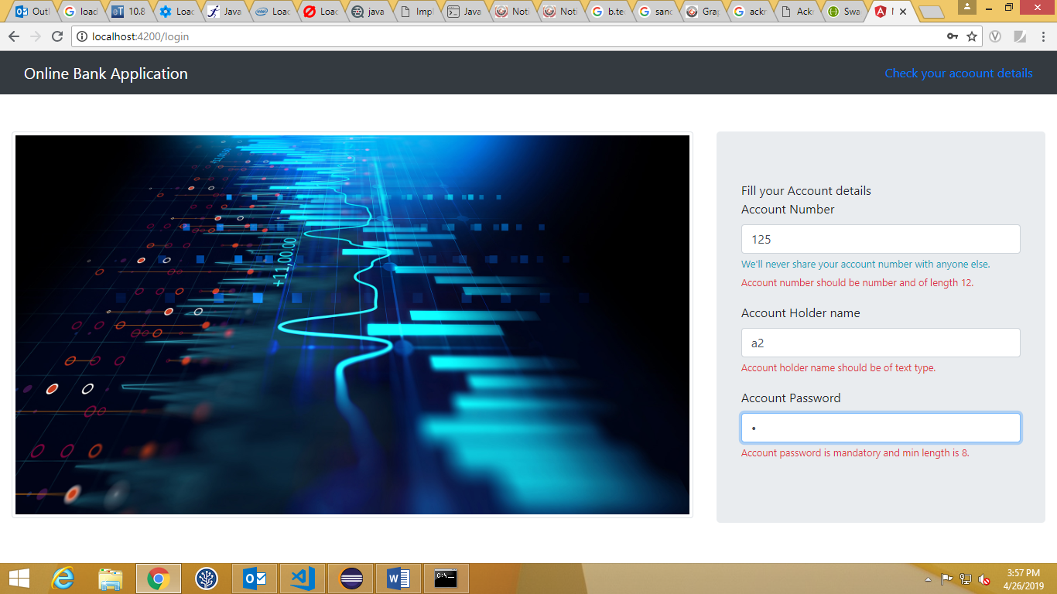
Black Box Testing

Slide 32
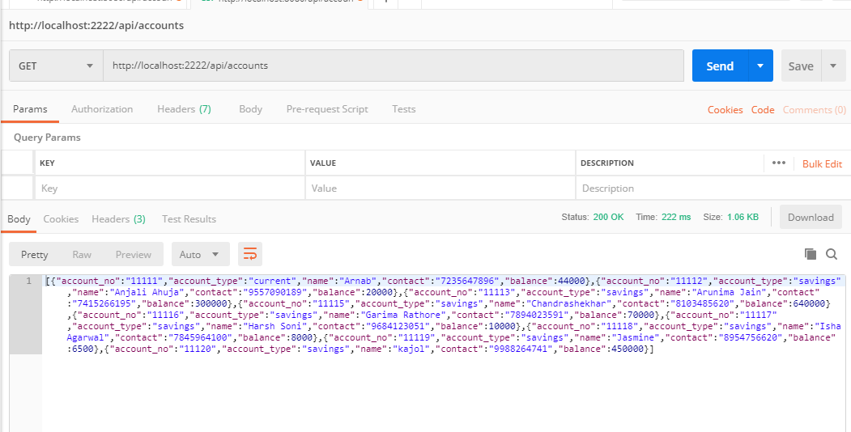
Testing of Java API
All account details

Slide 33
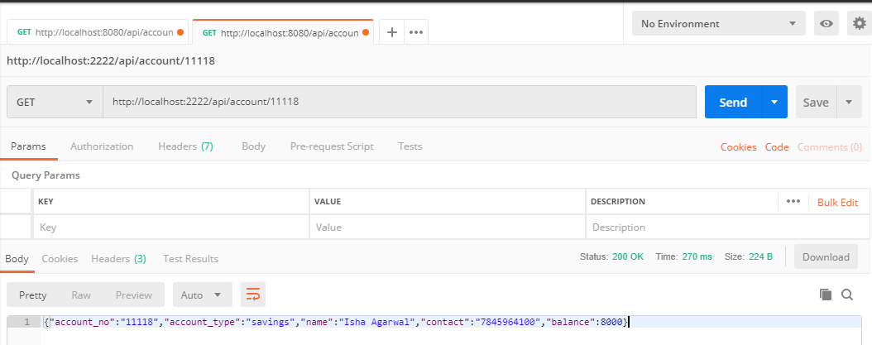
Testing of Java API
Account get by Id

Slide 34
Conclusion
With an open API economy, banks get an option to introduce their customers to new products and services through collation among the business units within a bank, across industries, and between banks and other complementary sectors of the economy, especially data businesses and technology.
Microservice splits monolithic applications into a set of services that communicate with each other through open APIs. Each service acts out one particular function pretty well.
It has come as a blessing for the banks because this approach will provide favorable circumstances to deliver value at subsequent intervals and not wait for a massive technology shift to happen.
Open API banking combined with microservices based architecture will define the success in banking space in the near future, where banks would be in a better position to accelerate time to market in the real sense.

Slide 35
Future Recommendations
Open Banking is one of the most exciting developments in financial services for years, with the potential to revolutionize how consumers engage with financial products and services.
The immediate future will likely be a deeper integration of microservice offerings in Google Cloud, AWS, and Azure because it can help them with their bottom line and make their resource usage in a more predictable manner.
I also see this as taking a large bite out of commercial virtualization software, and maybe even taking them out of business since containers offer much of the same end-result and we can use them on free and open source software.
From a developer perspective, having a hands-on experience in this field is beneficial due to the involvement of various technologies in it that are going to be vital in the near future of software development.

Slide 36
THANK YOU

